Slide 1
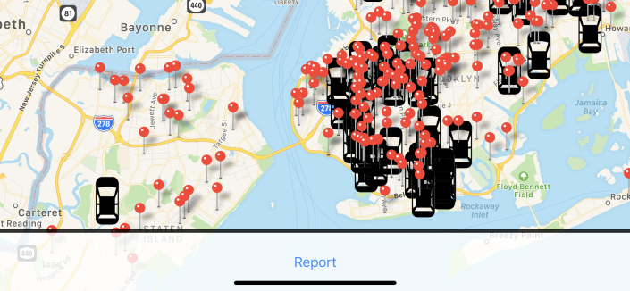


Seagull Security
Staten Island Technical High School
Notes:
Background/Problem - Adam
What The App Is - Sameer
Demo of the app / How it is designed - Eric and Matt
Misc/ Next Steps -
Shorter Version
Slides:
1
2
3
4
7
8
9
10
14

Slide 2

Introducing Seagull Security
Challenge Statement
Seagull Security is a mobile app that allows residents to make reports and notify the city of issues relevant to them and to view nearby incidents.
Notes:
Seagull Security is an innovative, efficient solution to exchanging information about our city to and from 311 services. By streamlining our solution into an all-in-one app, and by making our interface simple and easy to use, we dramatically boost convenience and user experience. Knowledge is power, and translating our app into real world information for the convenience of the user can potentially change the way wIt’s a replacement to the current ways the city communicates with its residents
An all-in-one tool solution to communication and information in the city e see safety andsecurity.
It’s a replacement to the current ways the city communicates with its residents
An all-in-one tool solution to communication and information in the city

Slide 3
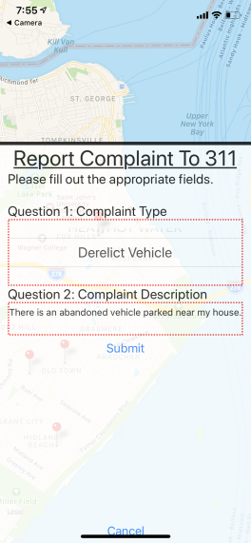
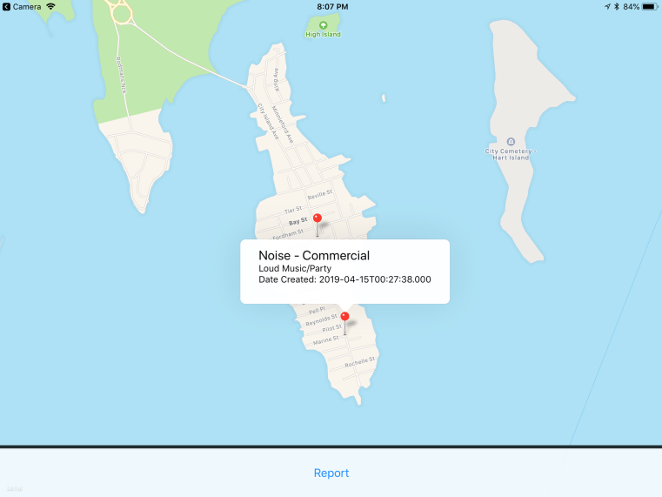
Features
Google Maps support for fast real-time tracking for any situation, accident or otherwise
Ability to report directly to 311 in an efficient way.
Real-time updates for alerts and brand new features in the future.
Notes:
Seagull security will release with a plethora of useful features for any citizen of NYC, including real-time updates for alerts and services, as well as multi-language support and real-time tracking for emergencies.
The ultimate Impact we expect to have through our project is to improve the safety and awareness for all New York City residents. We will evaluate our progress by monitoring We’ll Know we are achieving this when

Slide 4
Our Impact
The ultimate Impact we expect to have through our project is to improve the safety and awareness for all New York City residents. We will evaluate our progress by monitoring several data sources which include: Google Analytics, 311 services, app usage, and feedback from residents. We’ll know we are achieving this when New Yorkers trust and rely on the functionality of our 311 app.

Slide 5
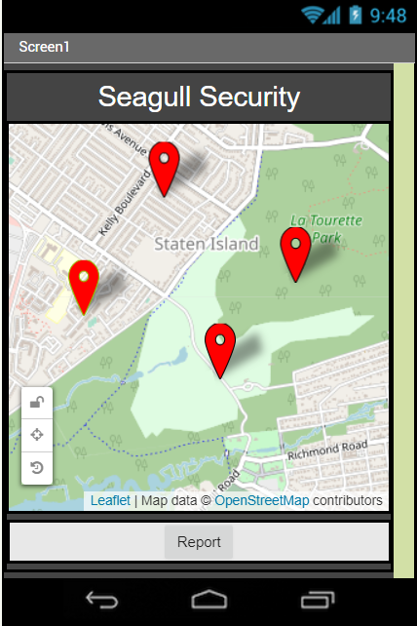

Last Time – Proof of Concept

Slide 6
This Time – Functional Application
https://snack.expo.io/@ericthestein/311-map

Slide 7
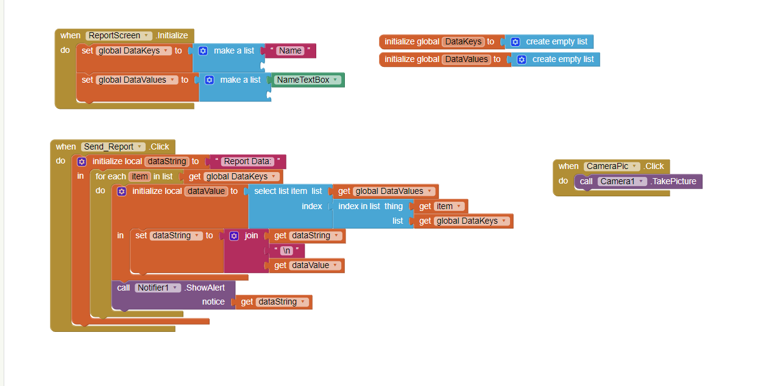
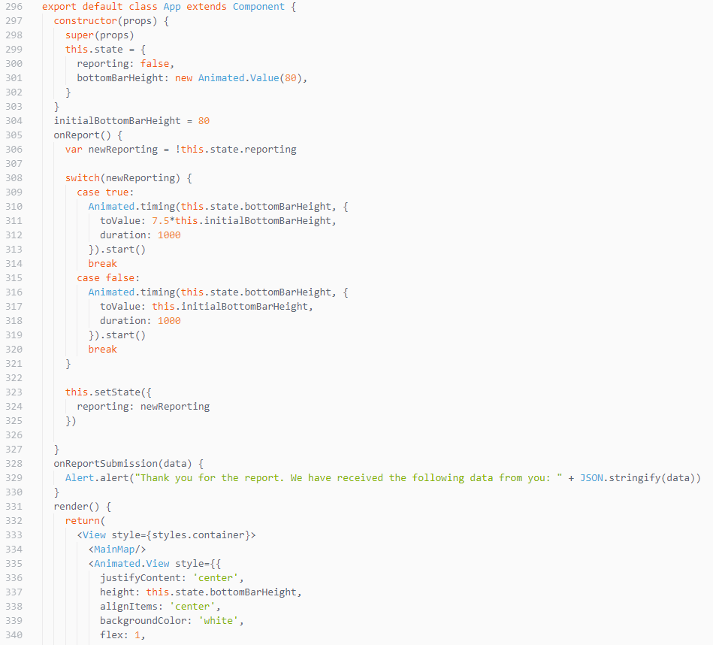
After
Before

Slide 8
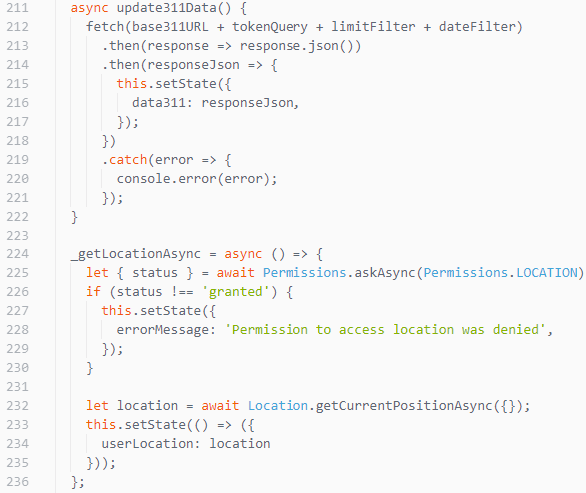
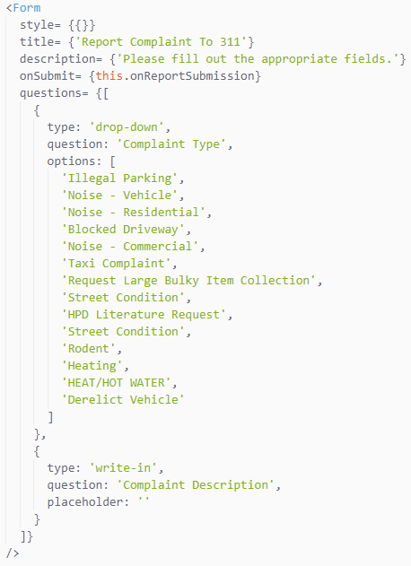
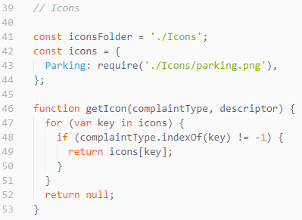
Code Snippets

Slide 9



Designing The App
Coded in React Native
JavaScript
HTML
Packaged using Expo.io
Uses APIs
Google Maps
311 Open Data (API Link: https://data.cityofnewyork.us/resource/fhrw-4uyv.json?)

Slide 10
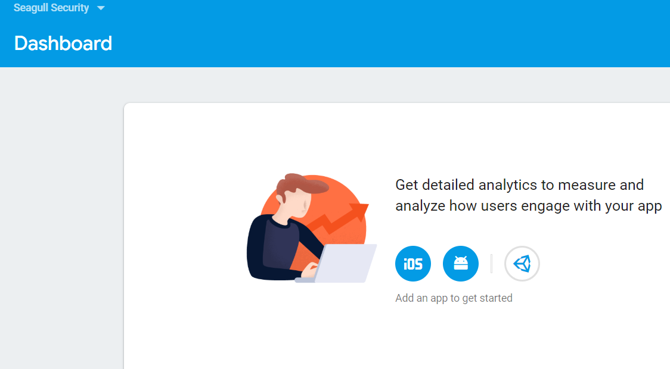
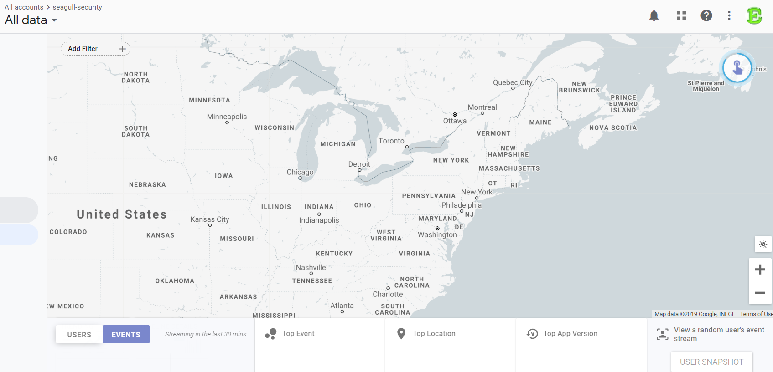
Metrics
Core Goal: Make residents safer and more informed about the city and the services it provides.
We will be looking at:
User Location
User Gender, Race, Age
User Event Streams (which describe the steps users take to complete certain actions)
Amount of reports and verified reports
App Reviews
Number of active users and downloads

Slide 11
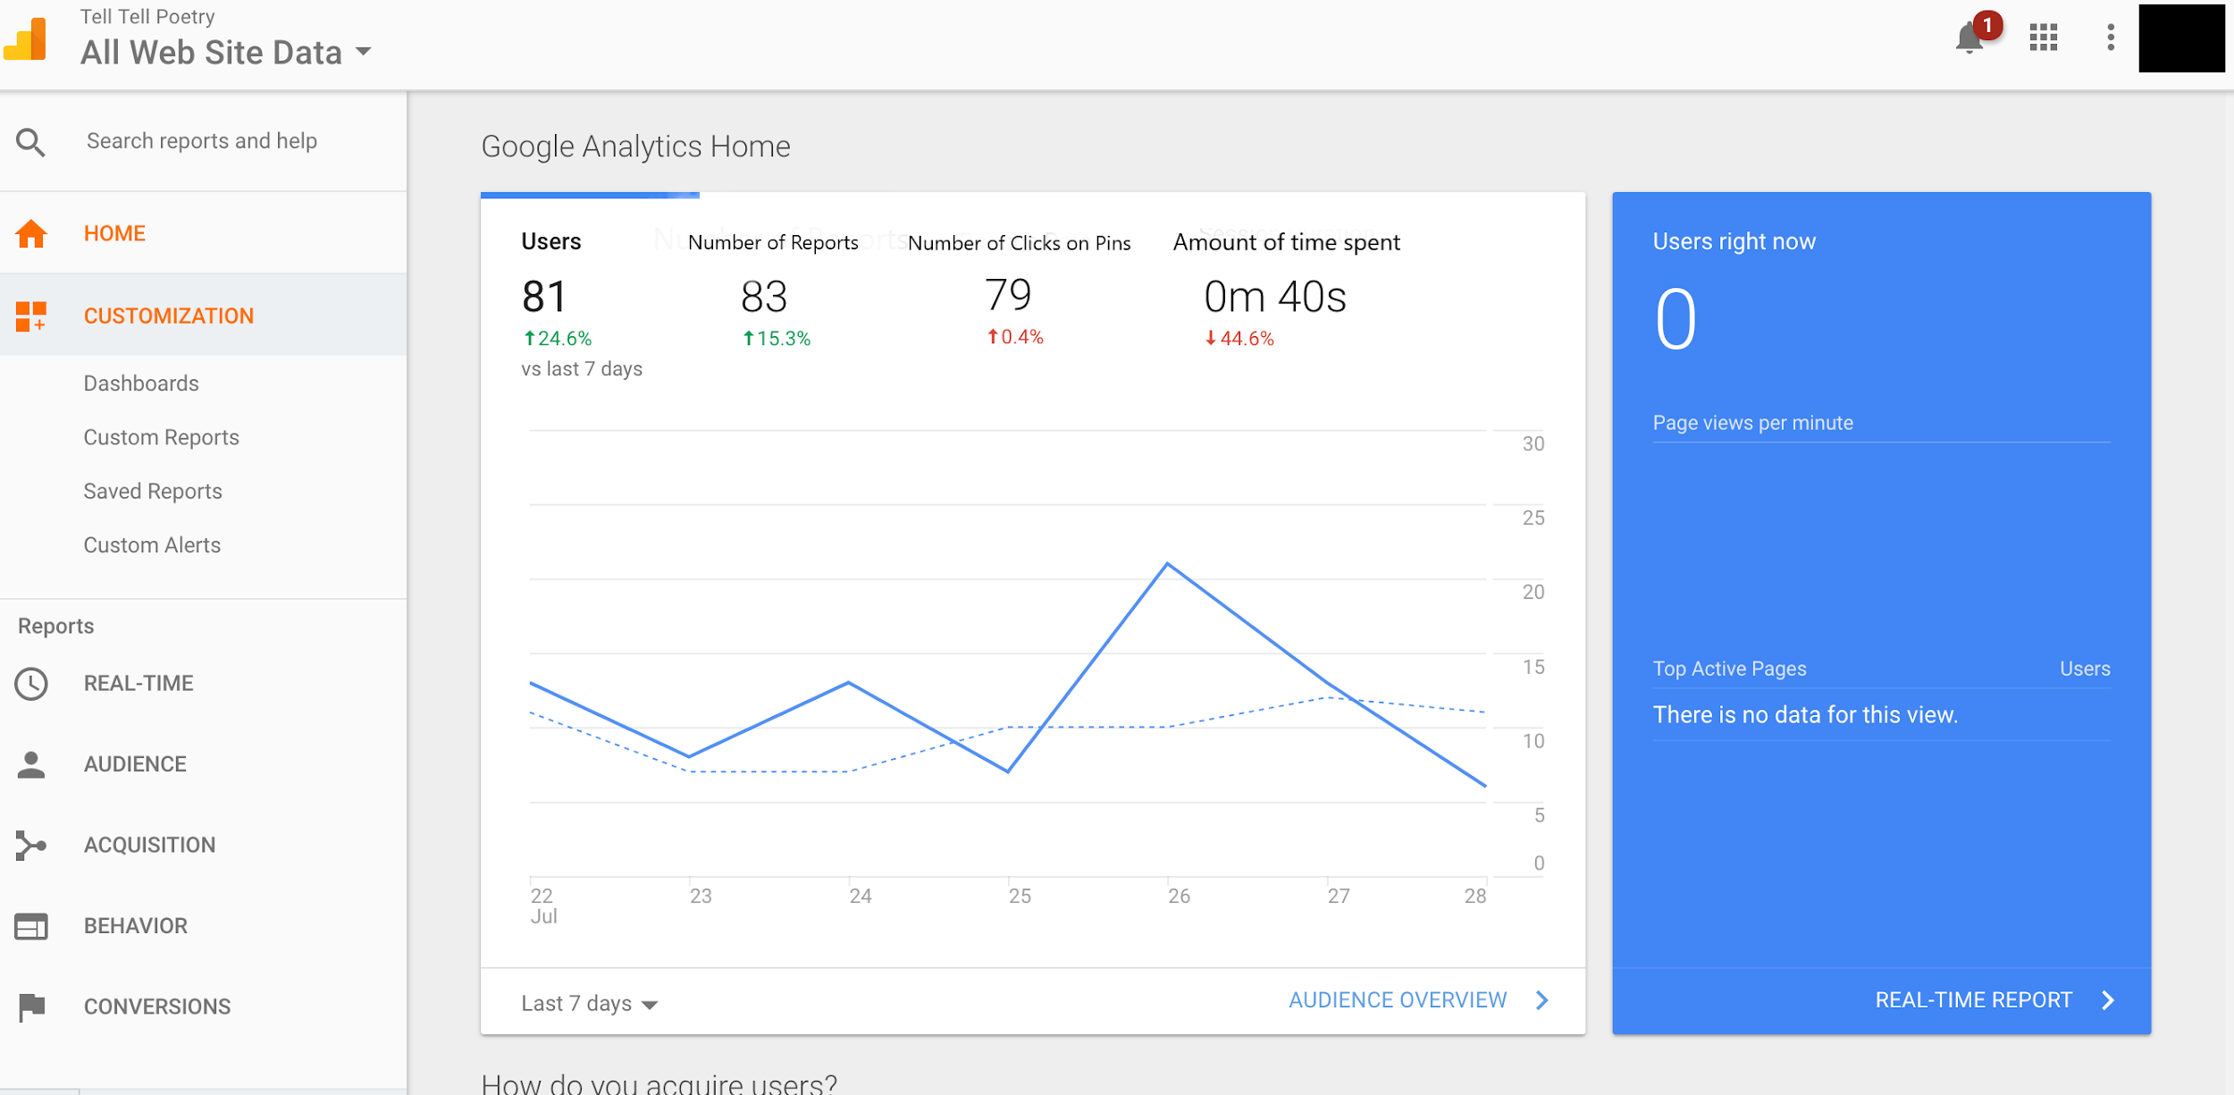
Example of Metric Dashboard (Using Google Analytics)

Slide 12
What impact or outcomes does your project want to achieve?
Our project will improve safety for residents, make it easier to submit complaints, increase accessibility to 311 data, allow politicians and government workers to review incidents affecting their constituency
Who will be most affected?
Investors, NYC’s government, citizens of NYC (and, eventually, other cities)

Slide 13
What are the data input sources that will tell you if your project is achieving that impact?
We will use Firebase and Google Analytics to track our metrics (which we can increment and log by communicating with these services from within the app). These metrics will allow us to improve the user experience, gauge the effectiveness of the report feature, and improve accessibility.
How will our indicators work?
Our indicators will allow us to determine whether certain races or genders of individuals have better access to our app, how we can improve the user experience, and how effective our report feature is. Our analytics can be shared publicly to allow users and other stakeholders to gauge the effectiveness of our app. They can interact with the data in real time

Slide 14

Using Computer Science
How did you use your computer science skills?
We created this app by using the foundation we developed from taking AP Computer Science Principles and Networking/Cybersecurity to learn to leverage React Native and online APIs to create a mobile application.
Why Computer Science?
Because of the opportunities provided by the invention and advancement of computing and the internet, we decided to use computer science; it allows us to both efficiently access 311 data and relay that data to New Yorkers and collect additional data to improve safety.

Slide 15
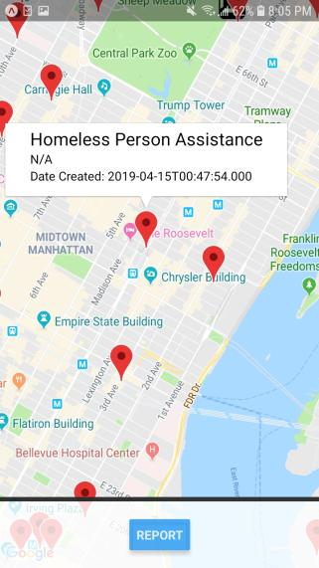
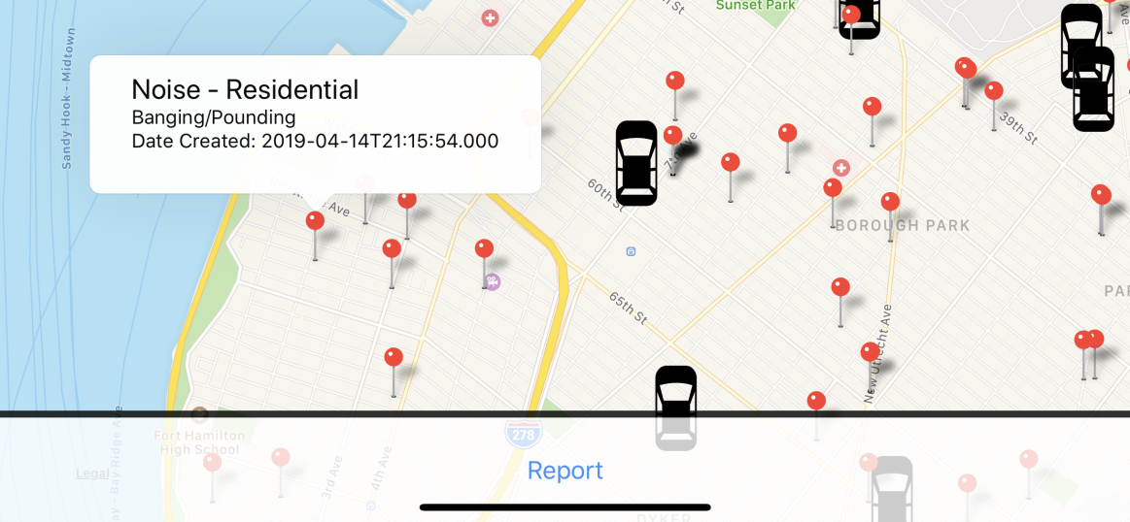
Next Steps
Integrate with the existing 311 app
Add the ability to attach pictures/videos to 311 reports
Add multi-language support to increase accessibility.
Add the ability to report incidents at locations that are not only at a user’s current location
Add a point system for successful and verified reports
help market the app
Allow users to subscribe to notifications
Extend functionality to other cities with 311 APIs

Slide 16
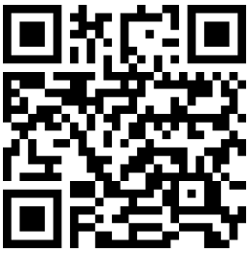
Test out the app yourself!
Please download Expo on your iOS or Android device and scan this QR code.

Slide 17

Contact Information
Project Title: Seagull Security
School: Staten Island Technical High School
Address:
485 Clawson Street
Staten Island, NY 10306
Phone:
(718) 667-3222
Fax:
(718) 987-5872
Our Teacher: Dr. Joseph Frusci
joseph.frusci@sitechhs.com

Slide 18
Citations:
What is 311 Data and Why is it Important? (2018, March 20). Retrieved from https://streamdata.io/blog/311-data-important/
Calgary, O. (n.d.). Retrieved from https://nycopendata.socrata.com/Social-Services/311-Service-Requests-from-2010-to-Present/erm2-nwe9
Mental Health Roadmap. (n.d.). Retrieved from https://thrivenyc.cityofnewyork.us/
(n.d.). Retrieved from https://www1.nyc.gov/311/
Calgary, O. (n.d.). Categories. Retrieved from https://data.cityofnewyork.us/browse?q=Location
[]. (n.d.). What Is 311? Retrieved from https://www.govtech.com/dc/What-is-311.html
(API Link: https://data.cityofnewyork.us/resource/fhrw-4uyv.json?)

